Slide 1

Context Free Grammar Lecture - 01

Slide 2
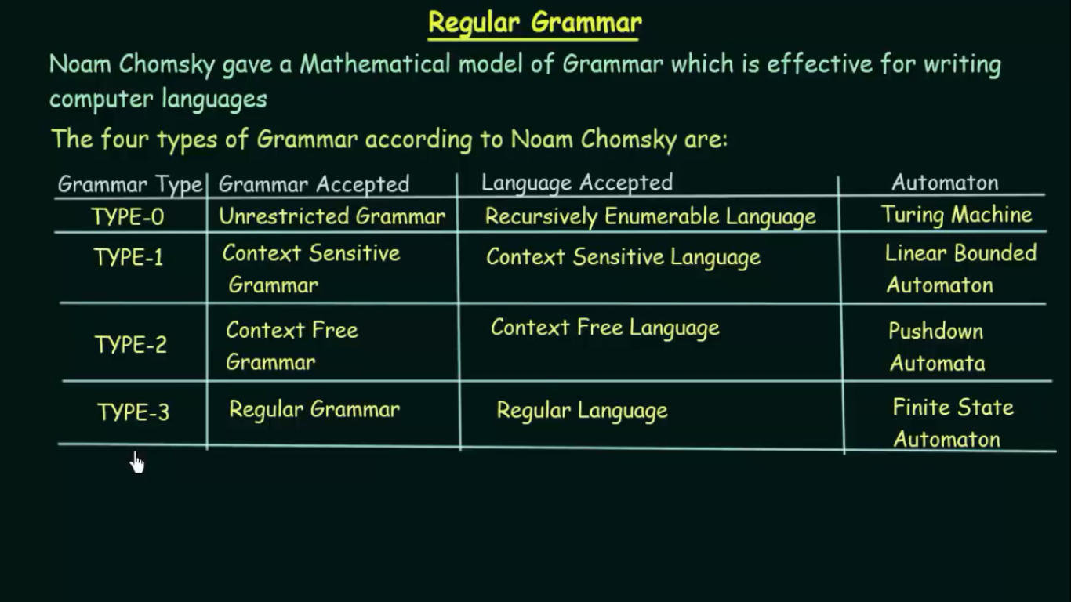

Slide 3
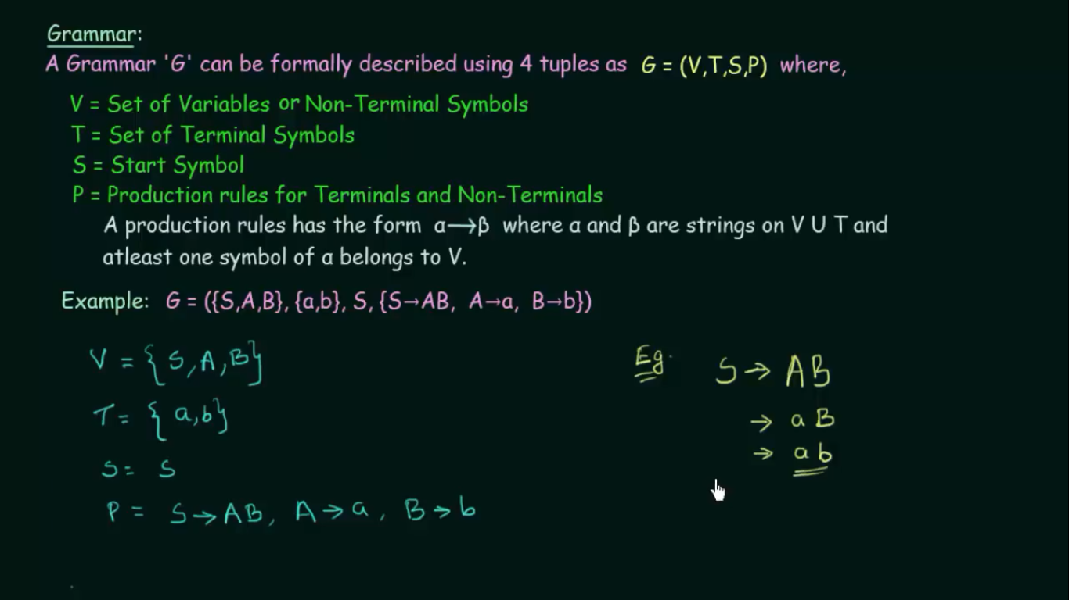

Slide 4
Example of CFG: Simple Arithmetic Expressions
Production rules
expr → expr op expr
expr → ( expr )
expr → - expr
expr → id
op → +
op → -
op → *
op → /
op → ↑
Terminals: id + - * / ↑ ( )
Nonterminals: expr, op
Start symbol: expr

Slide 5
Notational Conventions
Terminals
Lower-case letters early in the alphabet: a, b, c
Operator symbols: +, -
Punctuations symbols: parentheses, comma
Boldface strings: id or if
Nonterminals:
Upper-case letters early in the alphabet: A, B, C
The letter S (start symbol)
Lower-case italic names: expr or stmt
Upper-case letters late in the alphabet, such as X, Y, Z, represent either nonterminals or terminals (grammar symbol).
Lower-case letters late in the alphabet, such as u, v, …, z, represent strings of terminals.

Slide 6
Notational Conventions
Lower-case Greek letters, such as α, β, γ, represent strings of grammar symbols. Thus A→ α indicates that there is a single nonterminal A on the left side of the production and a string of grammar symbols α to the right of the arrow.
If A→ α₁, A→ α₂, …., A→ α_{k} are all productions with A on the left, we may write A→ α₁ | α₂ | …. | α_{k}
Unless otherwise stated, the left side of the first production is the start symbol.
Example: Applying these shorthand to previous example of CFG,
E → E A E | ( E ) | -E | id
A → + | - | * | / | ↑

Slide 7
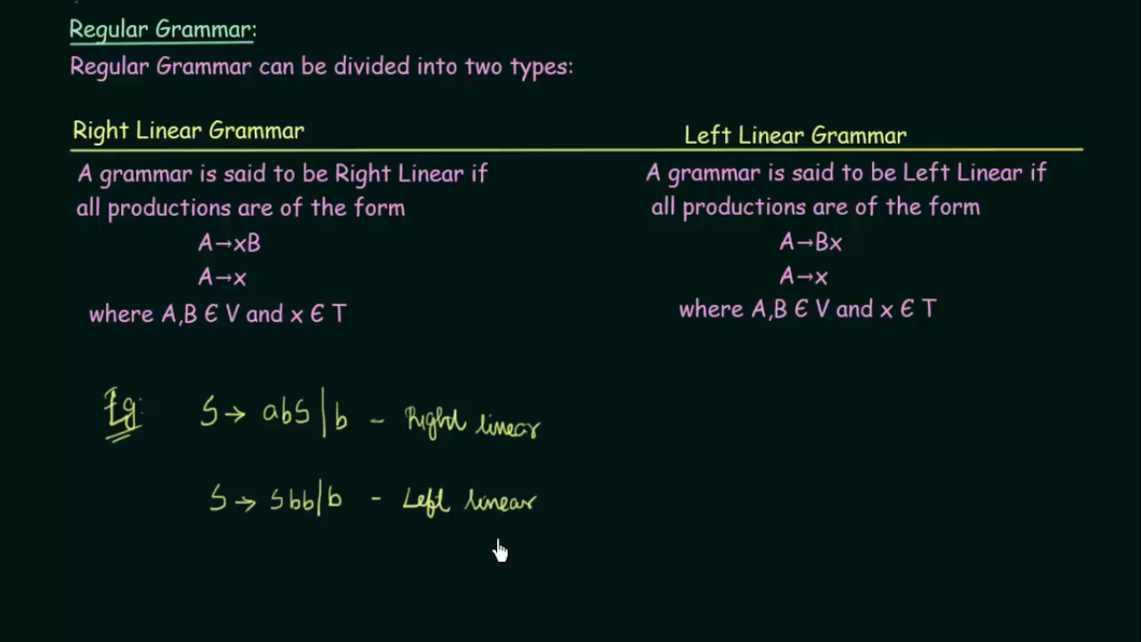

Slide 8
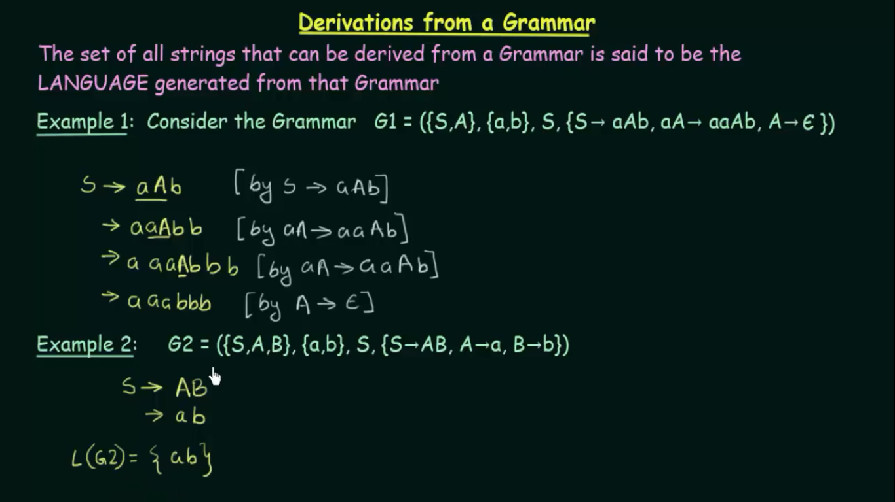

Slide 9
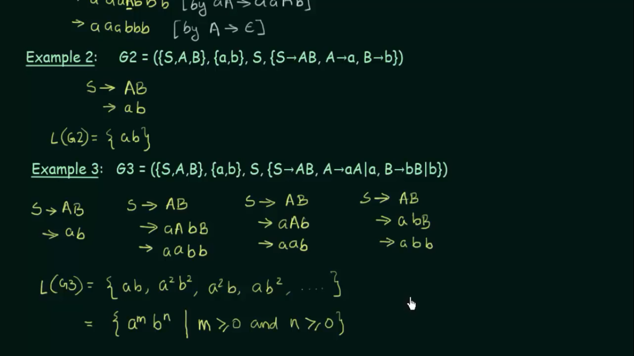
1
1

Slide 10
Derivations (the obtaining or developing of something from a source or origin.)
In general, a derivation step is
αAβ ⇒ αγβ if there is a production rule A→γ
α and β are arbitrary strings of terminal and non-terminal symbols
If α₁ ⇒ α₂ ⇒ ... ⇒ α_{n} , then “α_{n} is derived from α₁“ or “α₁ derives α_{n}”)
⇒ : derives in one step
⇒ : derives in zero or more steps
⇒ : derives in one or more steps
*
+

Slide 11
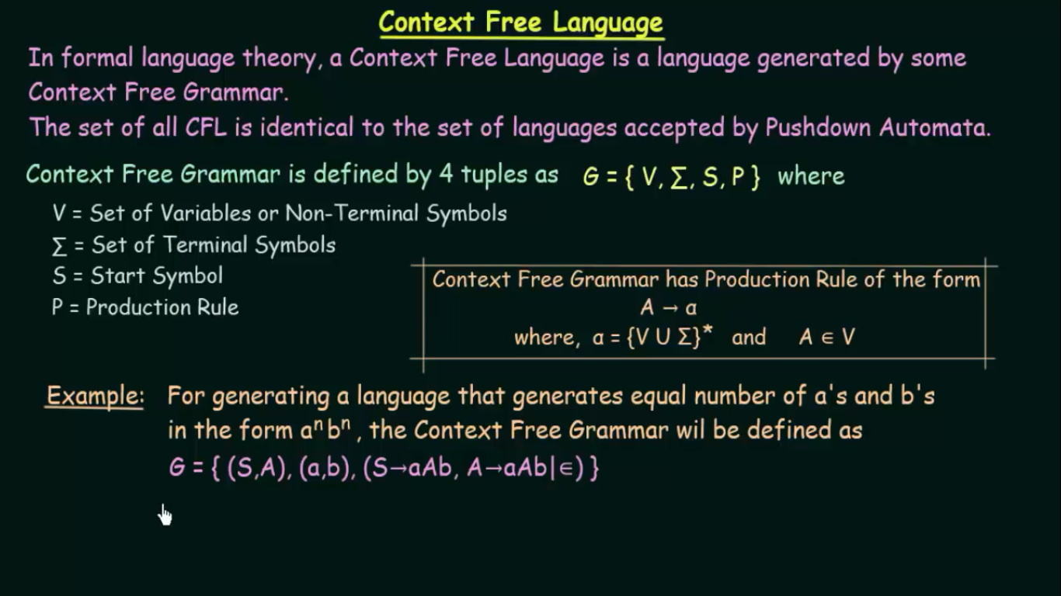

Slide 12
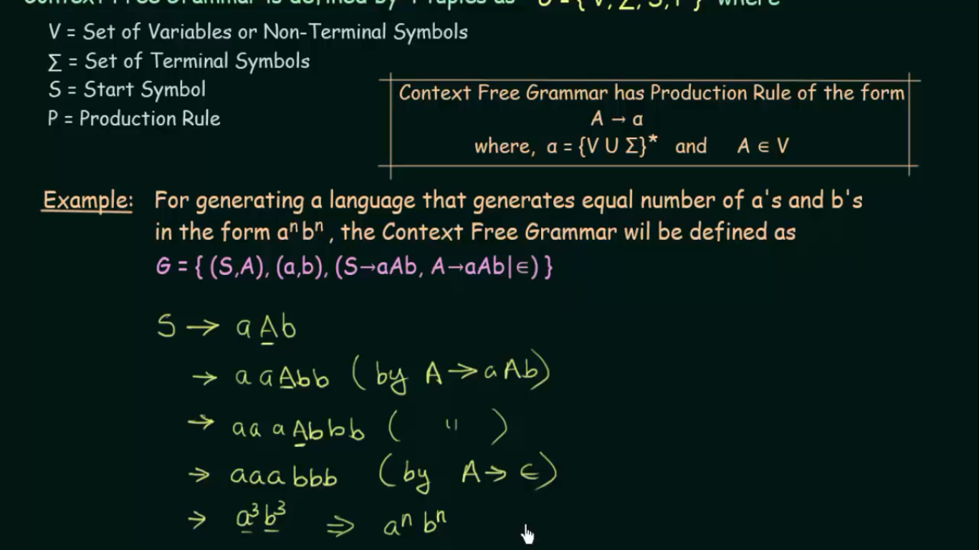

Slide 13
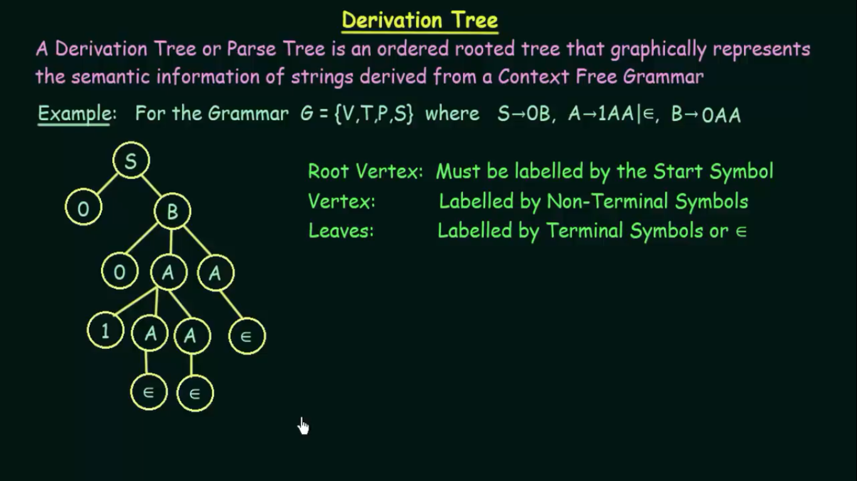

Slide 14
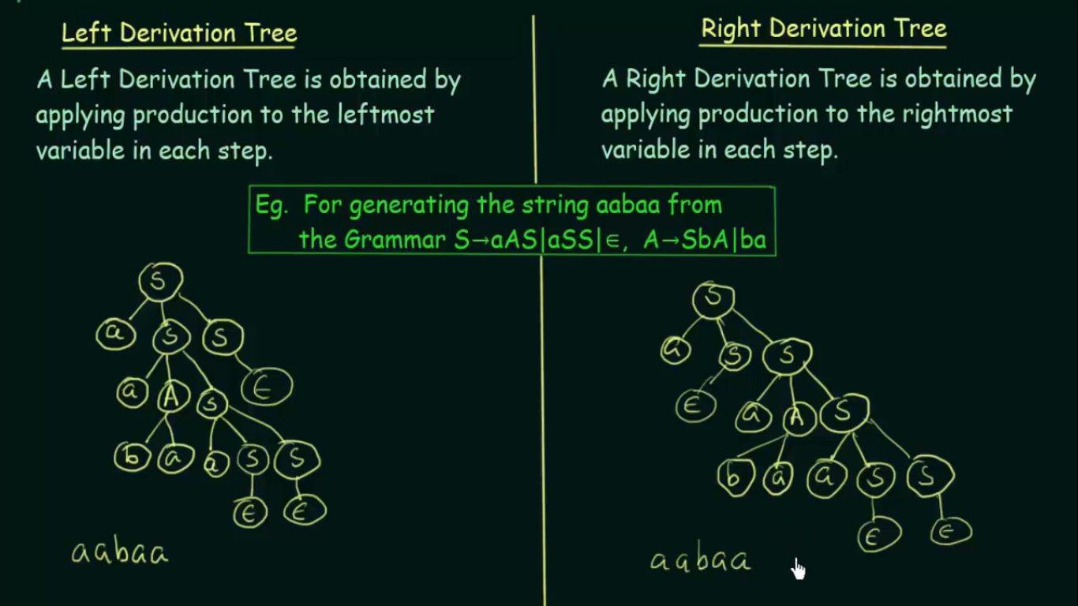

Slide 15
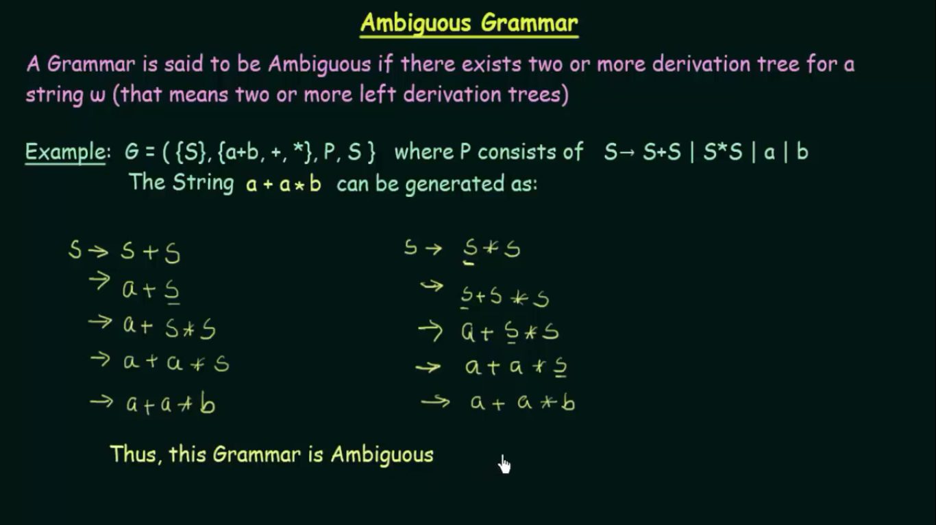

Slide 16
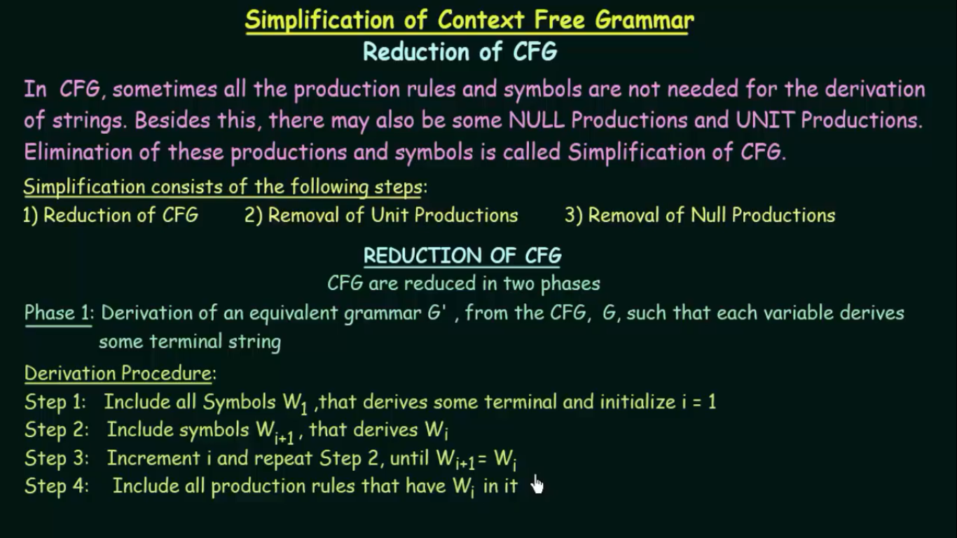

Slide 17
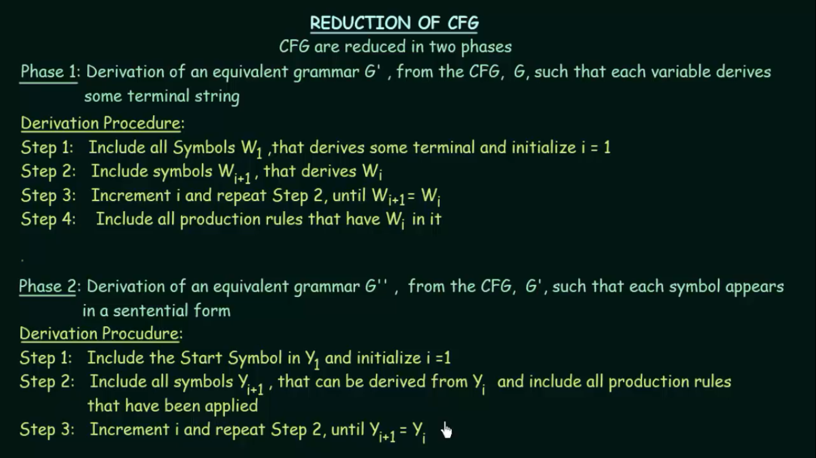

Slide 18
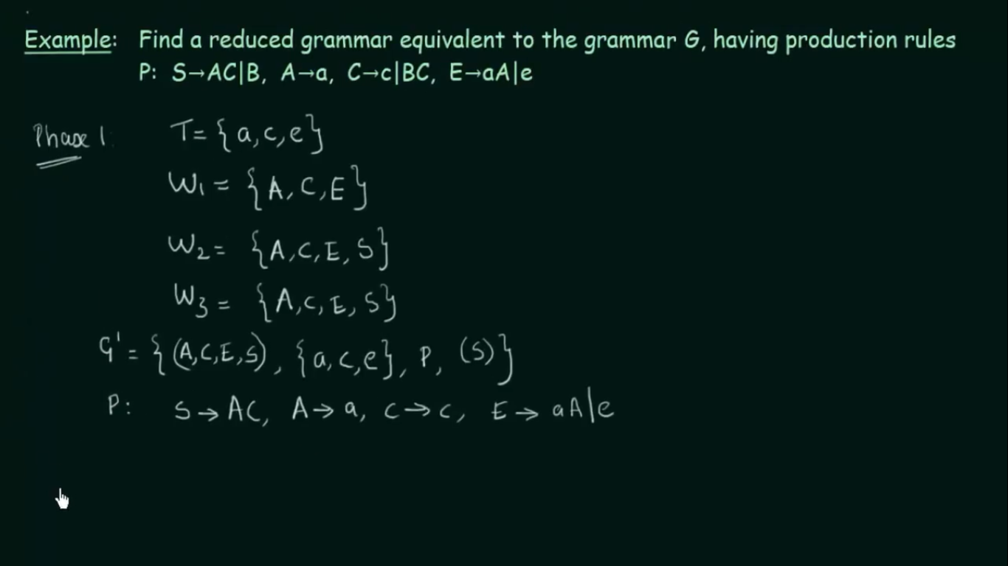
P = Production Rules

Slide 19
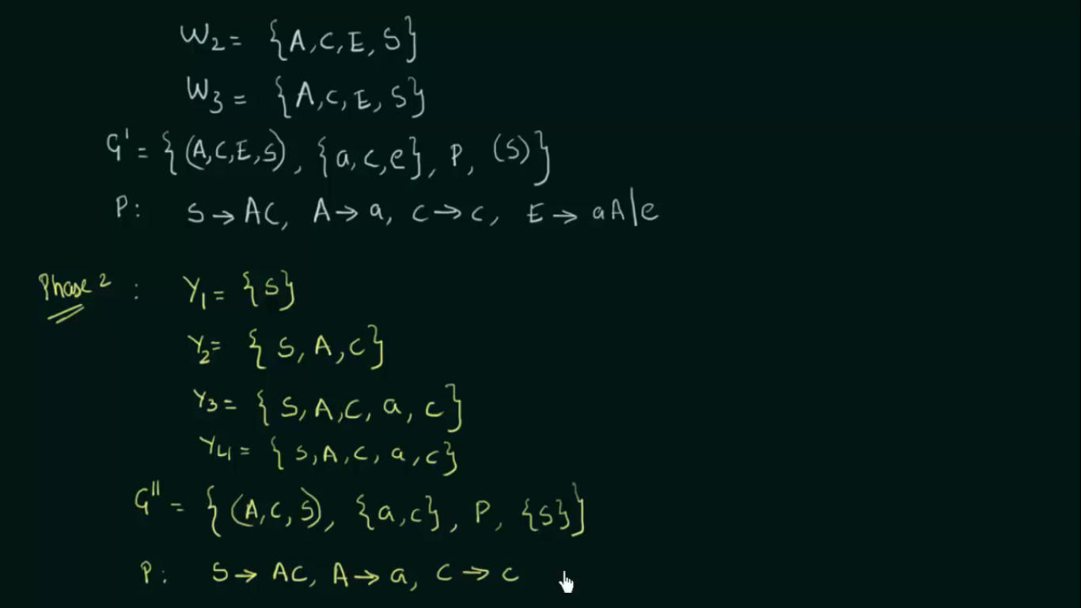

Slide 20
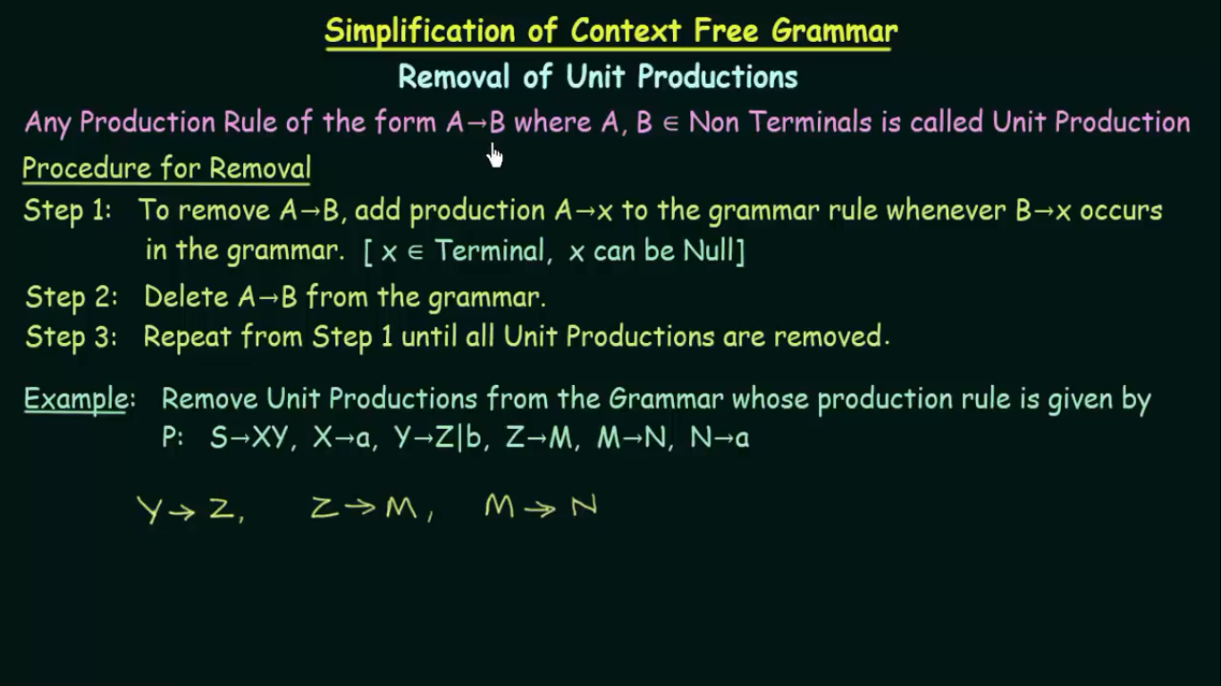

Slide 21
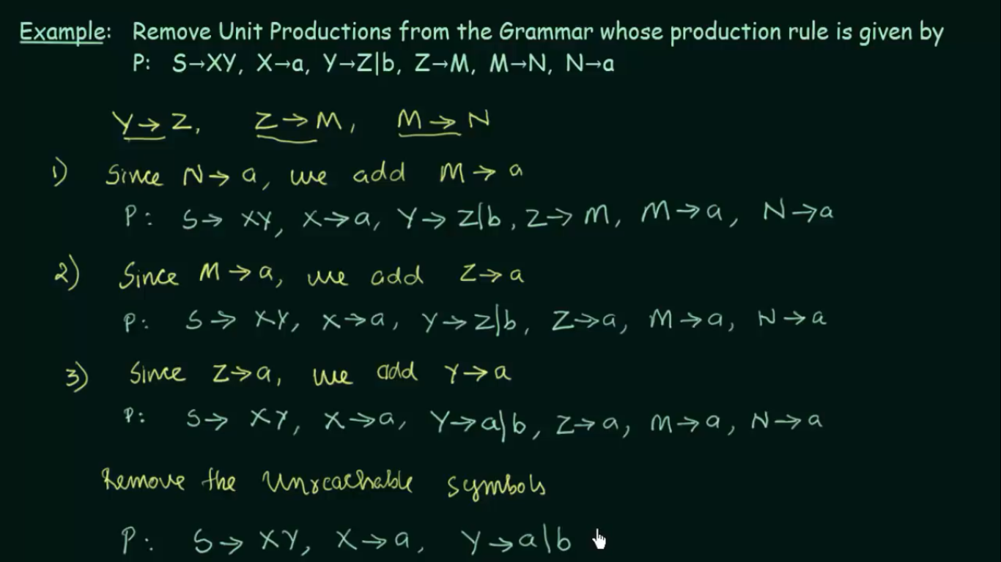

Slide 22
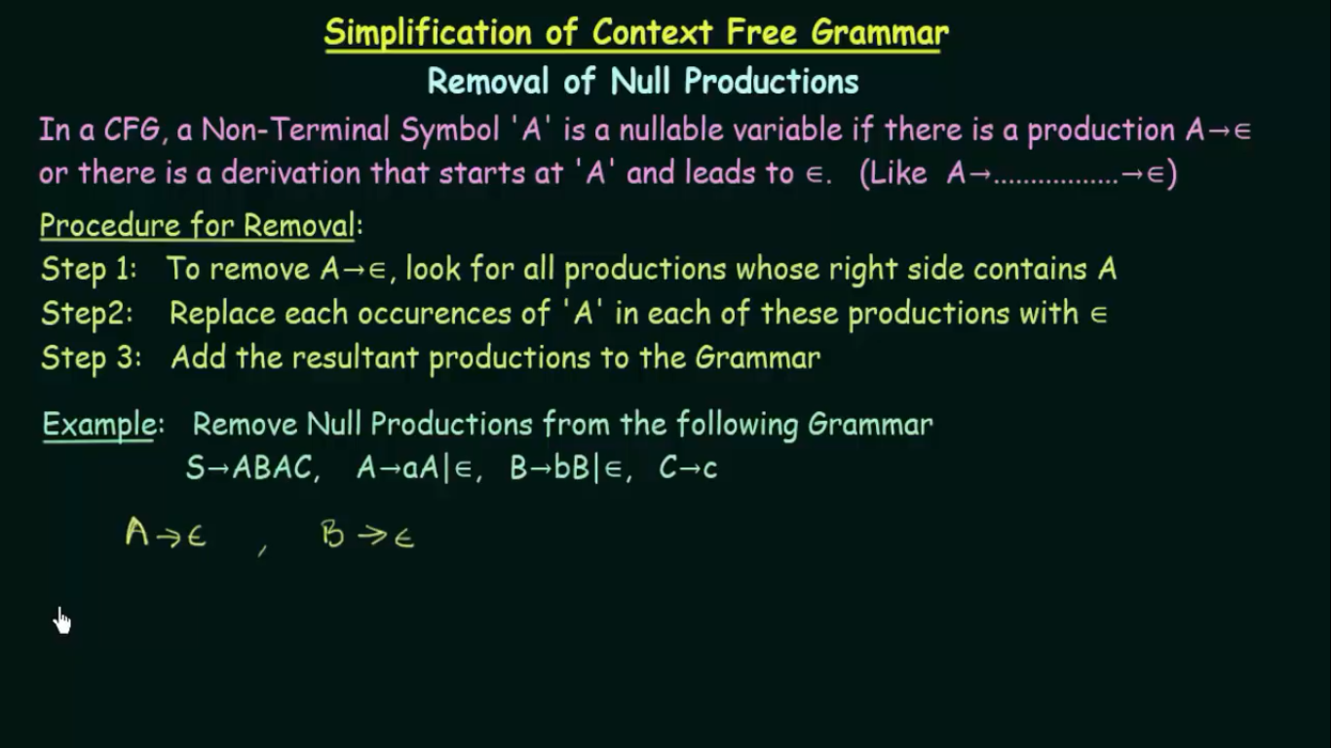

Slide 23
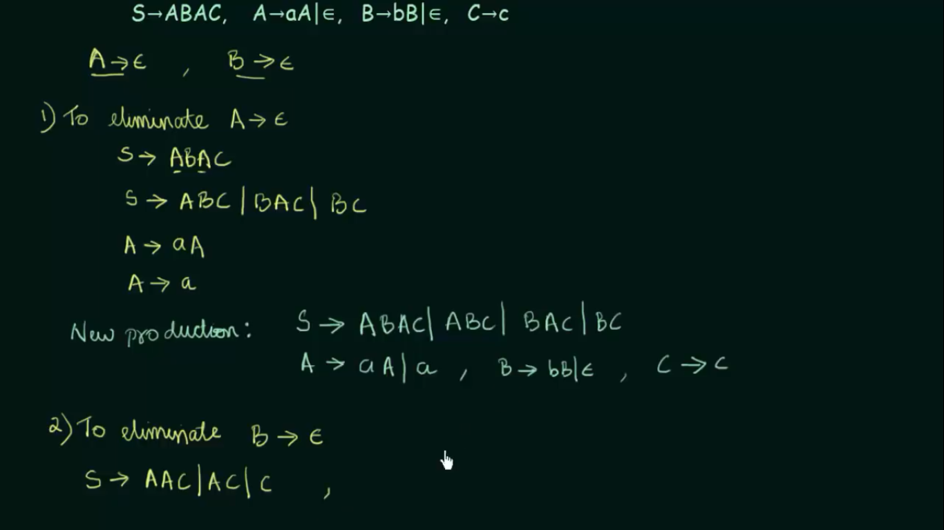

Slide 24
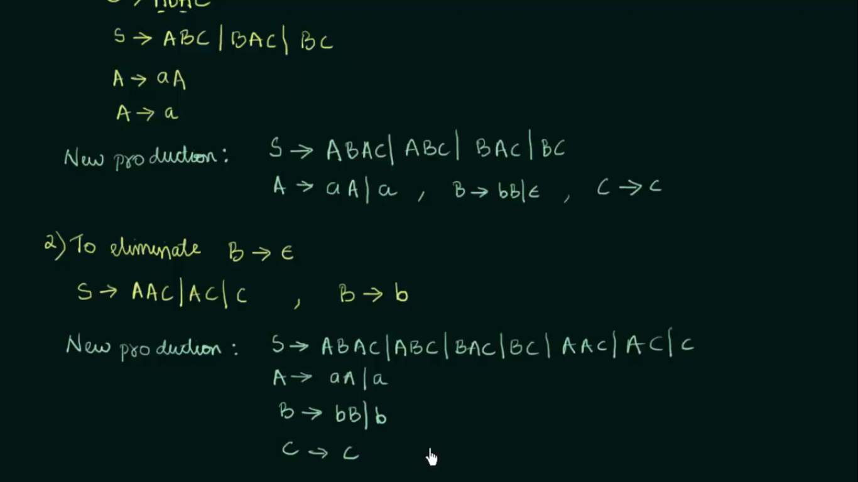

Slide 25
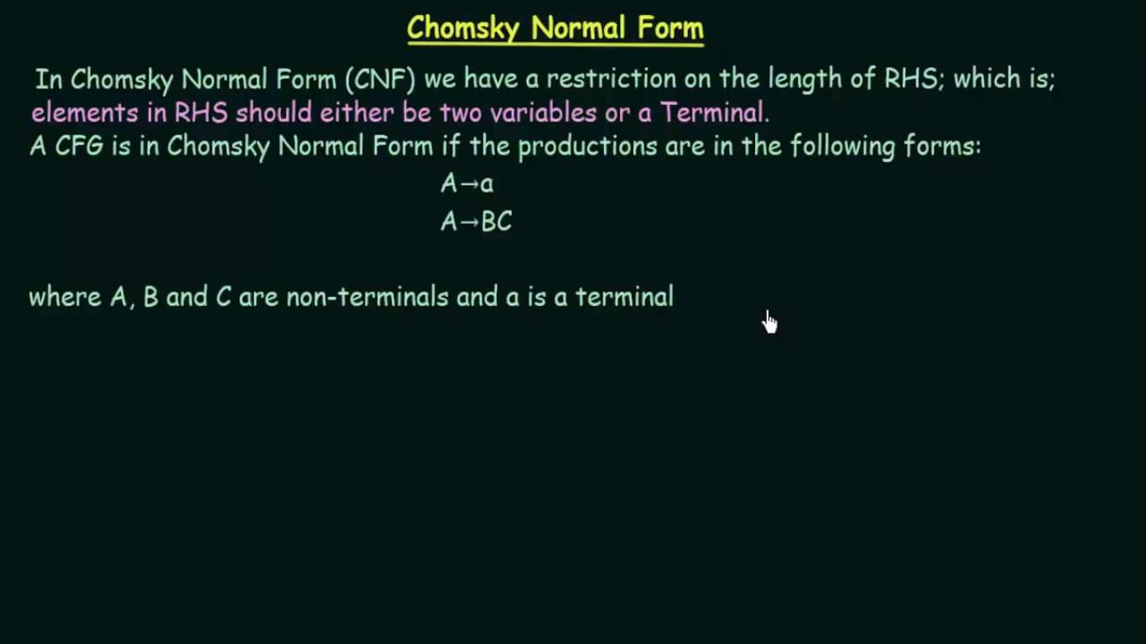

Slide 26
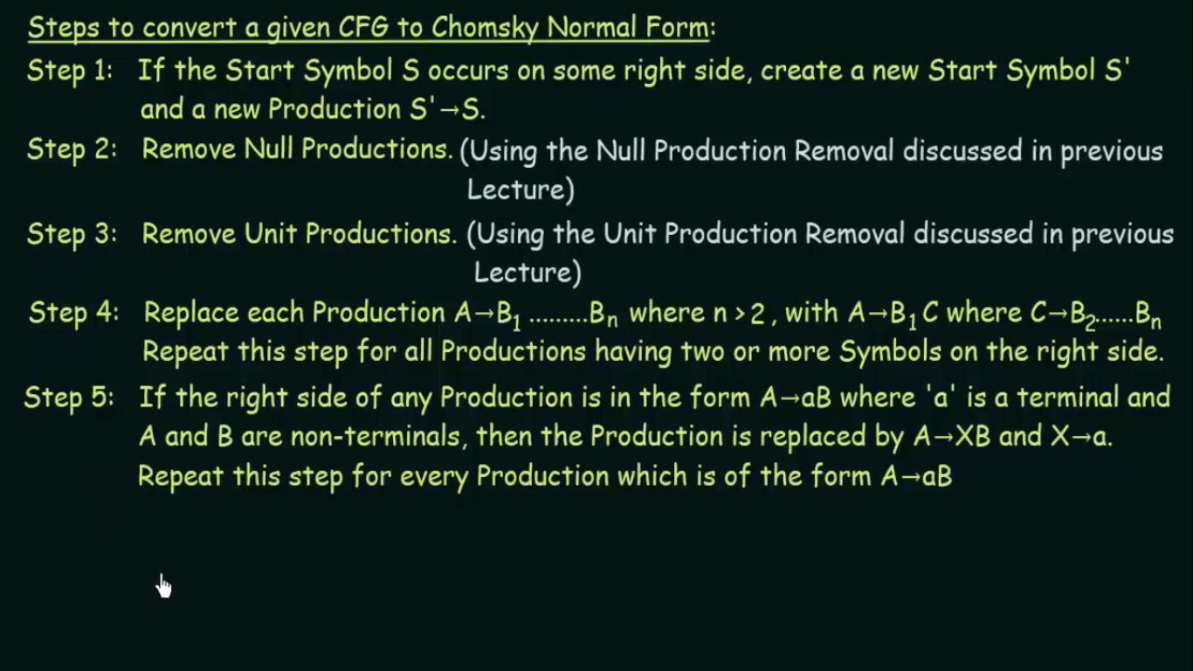

Slide 27
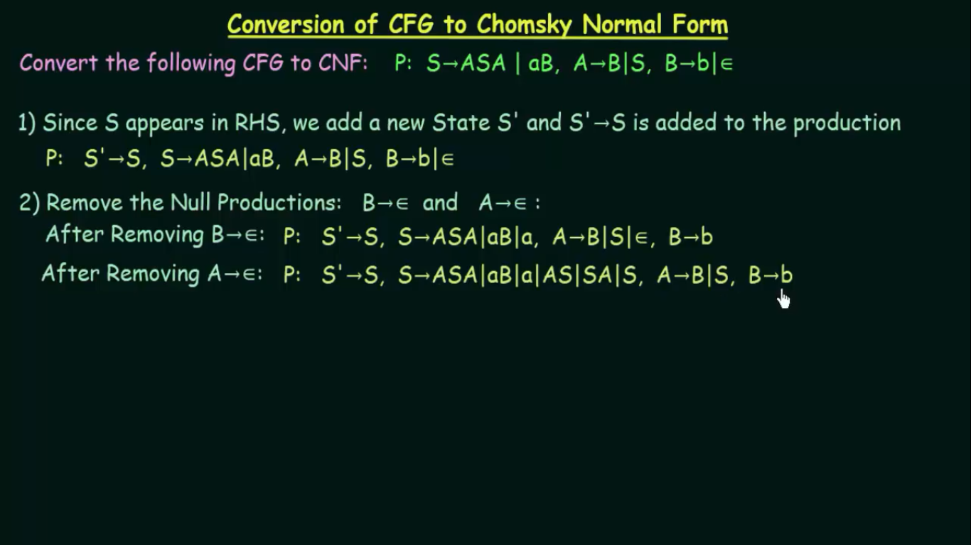

Slide 28
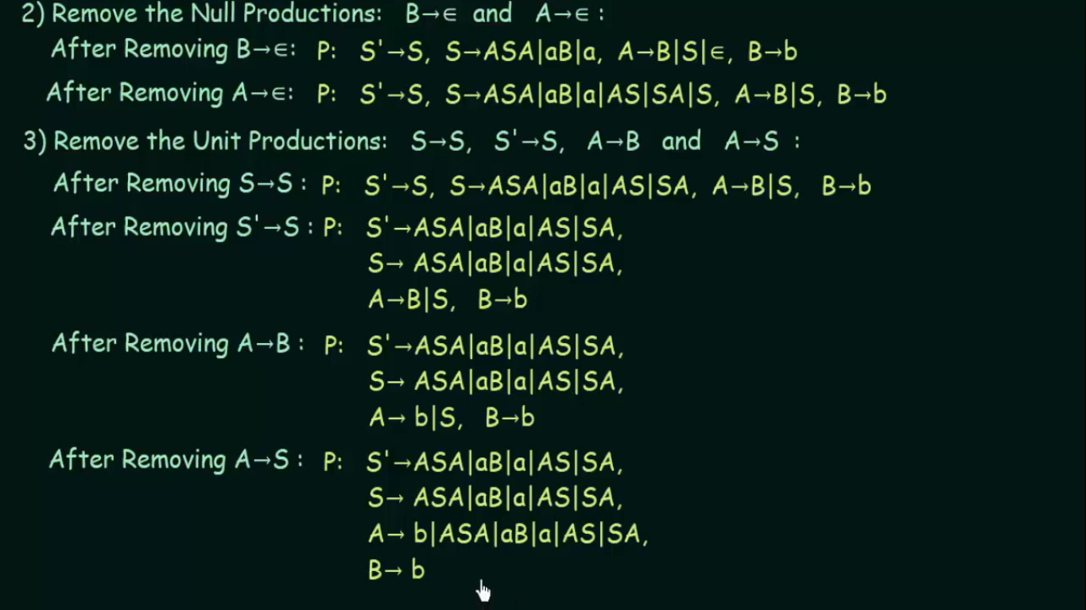

Slide 29
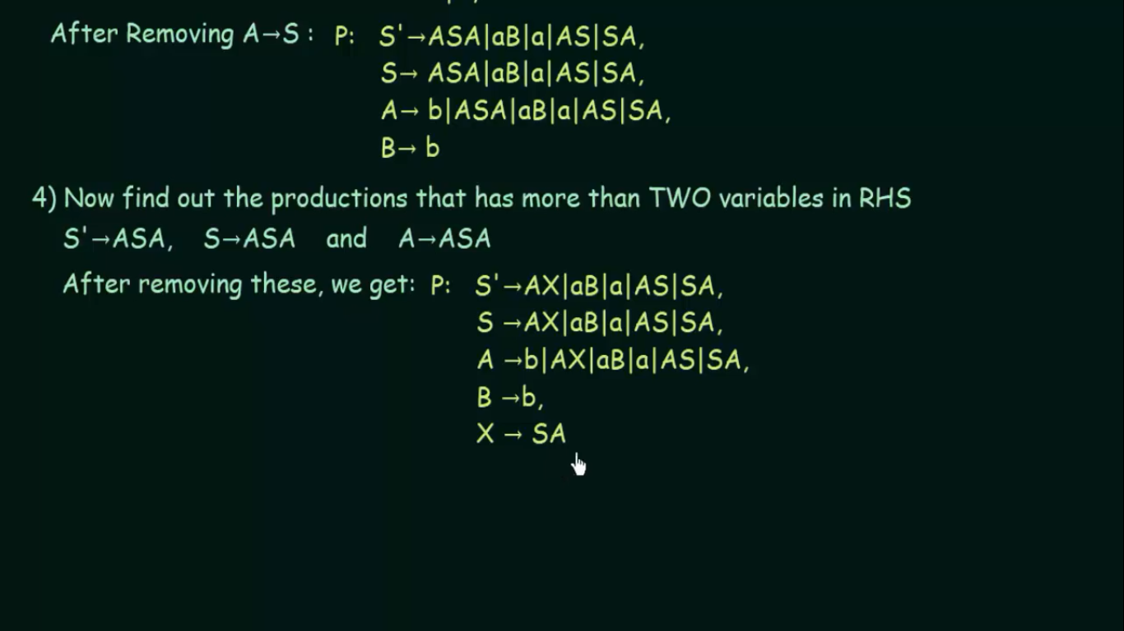

Slide 30
